Slide 1
CureMD Inventory
Trouble Shooting and Stock Counts
Sarah Barker

Slide 2
Who here is already utilizing the Inventory Module in CureMD ?
Are any of you an Inventory License holder for your Health Department?

Slide 3
Inventory Access
Inventory Access is based off a per license purchase on your CureMD Contract
Additional Licenses can be added at any time!
How do you know if you are a Licensed User to have Access to Manager Inventory?
The Inventory Module is located at the top of the page

Slide 4
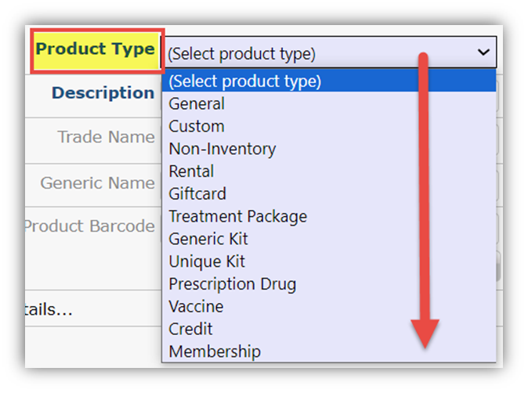
Inventory Management
Who is in charge of managing product within the module for the client ?
The client is in charge of managing the products that are needed for rendering patient services.
Commonly used products are:
Vaccine/Immunizations
Prescription Medications
Injections
Medication Kits

Slide 5
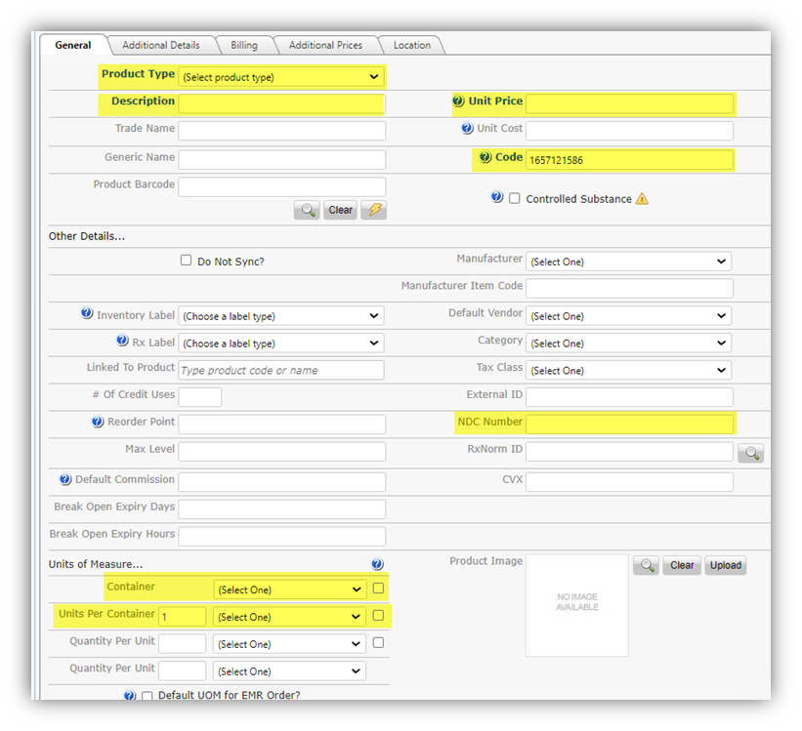
Product Type
Unit Price ($0)
Description/Name
Product Code
NDC Number
Container/Box
Units Per Container

Slide 6
Converting NDC Codes
Who knows how to convert a 10 Digit NDC Code into an 11 Digit NDC Code?

Slide 7
Class is in Session! How to Convert to an 11 Digit NDC Number

Slide 8
Quiz Time !

Slide 9
Which is the Correct NDC for this Prevnar 13?
0005 -1971-01
00050-1971-01
00005-1971-01
0005-1971-001
00050-01971-01

Slide 10
B. 00005-1971-01

Slide 11
Which is the Correct NDC for this Amoxicillin?
0781-2020-05
00781-02020-05
0781-02020-05
00781-2020-05
0781-2020-005

Slide 12
C. 00781-2020-05

Slide 13
Which is the Correct NDC for this TDVAX?
14362-111-03
14362-0111-03
14362-1110-03
14362-0111-003
014362-111-03

Slide 14
A. 14362-0111-03

Slide 15
Have you ever received this notification upon scanning a product from inventory?

Slide 16
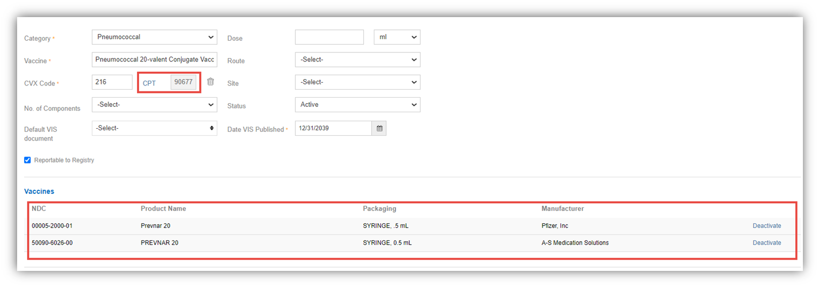
What to confirm when adding a product to Inventory?
Correct NDC of Use, not NDC of Sale
Proper CPT Code under Billing Tab in Product Record
CureMD Vaccine Library Check
Settings > EHR > Vaccine

Slide 17
WHAT’S NEW WITH INVENTORY!?

Slide 18
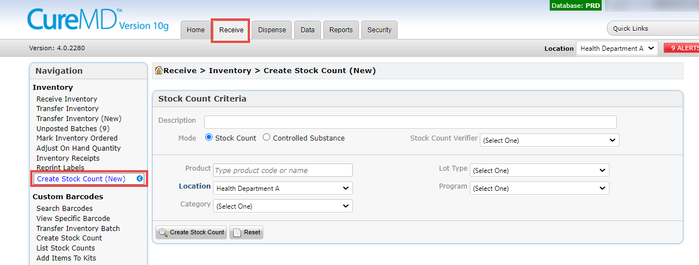
New Inventory Stock Count
Inventory > Received Tab > Create Stock Count (NEW)

Slide 19
Classic vs. New
Classic
New
Has anyone used the “New” stock count yet?
Key Benefits of the NEW Stock Count:
Maximizing Efficiency
Controlling Consistency
Exploring Additional Stock Count Criteria

Slide 20
New Inventory Stock Count
Description Field : Gives the capability to Name the Stock Count, if a Description is not added, one will be automatically generated for the Stock Count
Stock counts can be performed for Specific products, categories, Lot types, and Programs, or for your entire inventory without selecting any of the search criteria
Once selections have been made, select “Create Stock Count”.
A list of all barcodes with Inventory quantities will then be displayed.

Slide 21
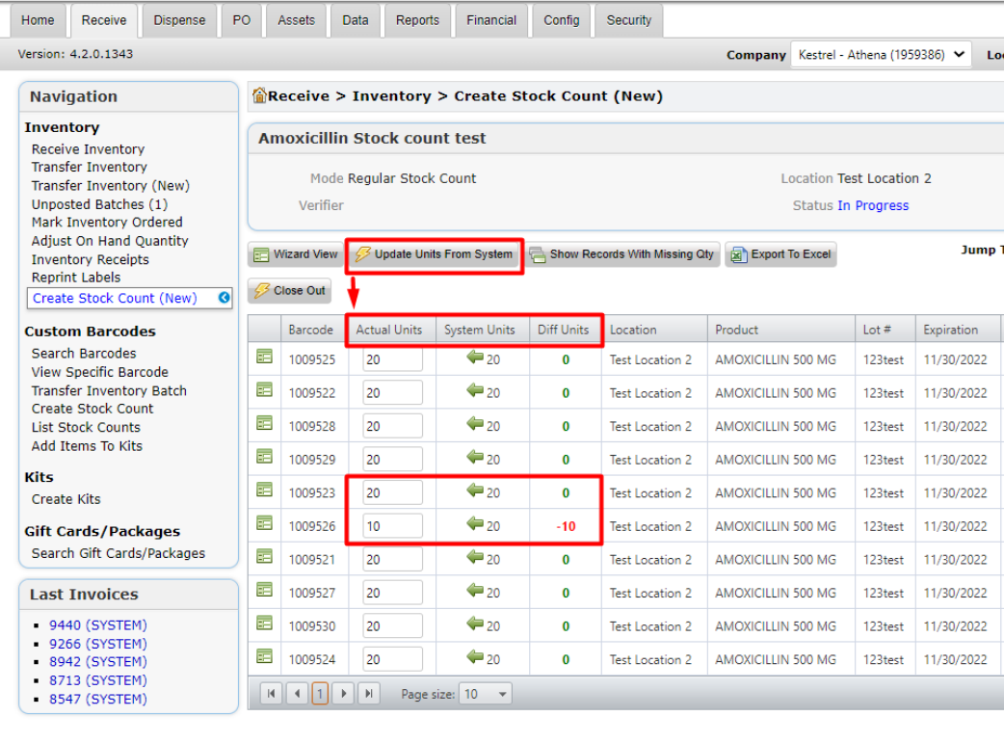
Updating Units From System Field
To Complete stock count – the “Actual Units” field must be filled in.
To save time, you can select “Update Units from system” to pre-populate the system units into the “Actual Units” Field and modify from there.

Slide 22
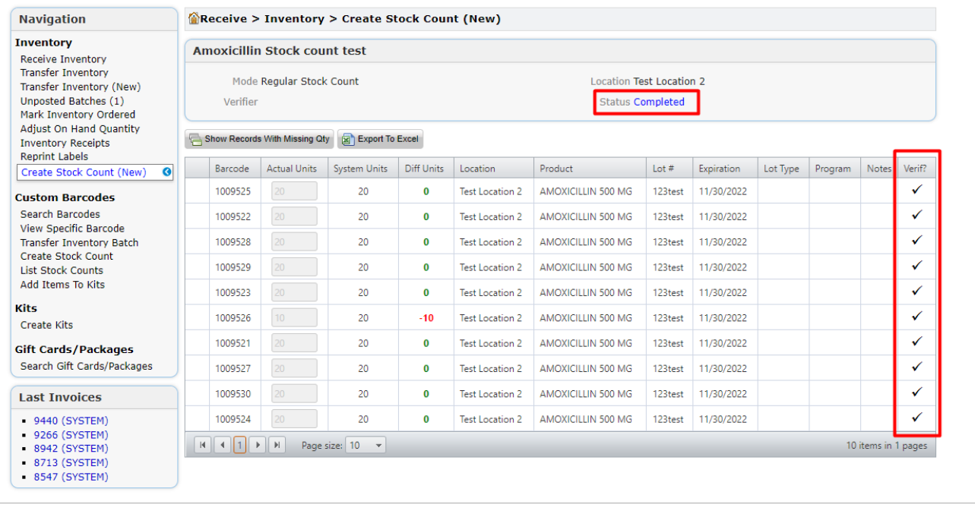
Completing the Stock Count
Once finished, Select “Close out” and when prompted select “Yes”.
Your stock will reflect as completed and verified in the next screen.
All changes will be recorded with the correct number of units.

Slide 23
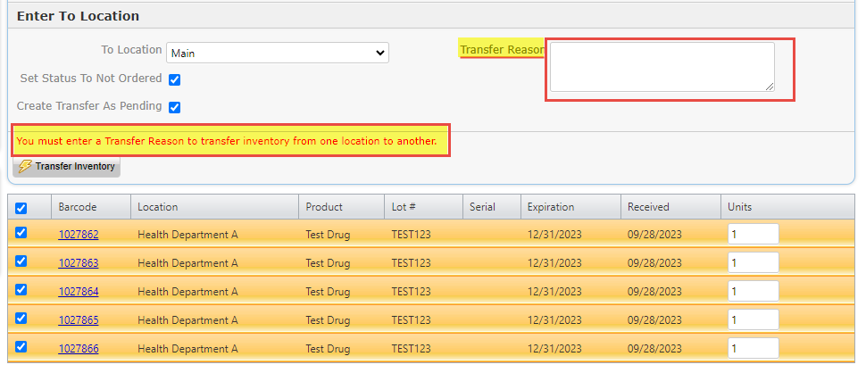
NEW Transfer Reason Requirement for Internal Inventory
Multiple Location Transfer of Stock/Inventory
Within your practice, you can transfer from site to site
Reporting off of Transfer Reason
Marking Transfer Reason as Required (NEW)

Slide 24
How can we improve YOUR inventory experience?

